Slide 1
Англиски јазик 7(седмо одд.)
Тема 3: Музика и омилени ТВ програми
Наставна единица :Увежбување на усвоен вокабулар:,,Места во градот “
(Places in a town) и опишување на градот
ЦЕЛИ:Учениците да практикуваат усвоени лексички единици од темата :Места во градот
Да се оспособат да го опишуваат градот со употреба на предлози за место

Slide 2
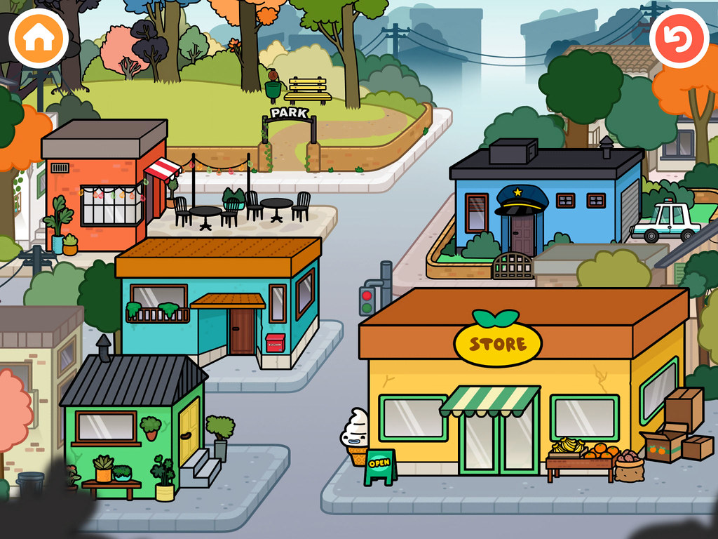
Step 1:match the following pictures with the words

Slide 3
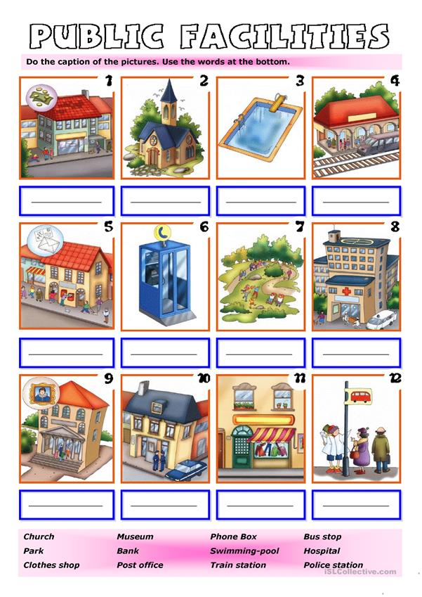

Slide 4

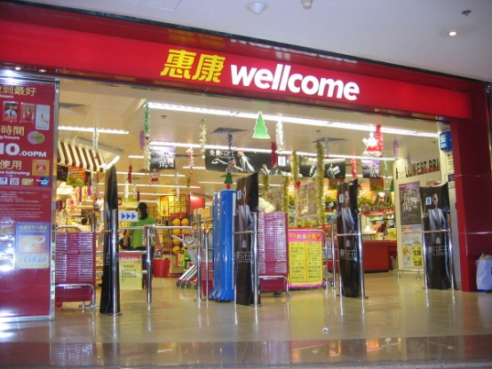
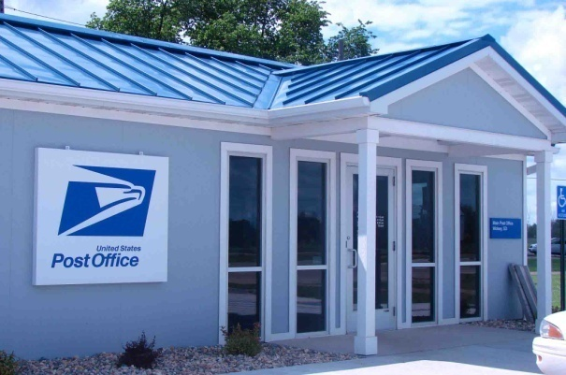

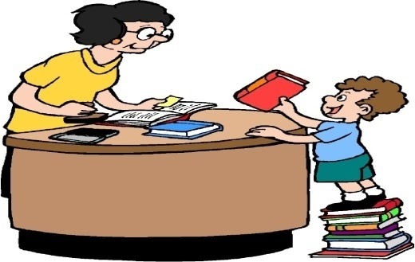
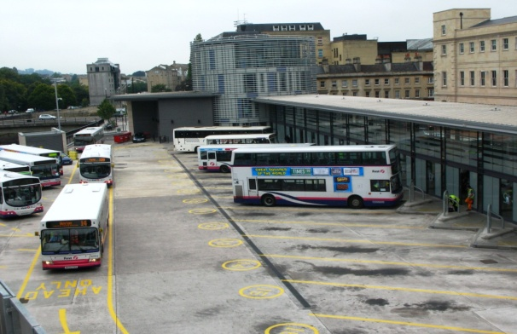
Answer:
Where can you watch a film? I can
________________________________________________
2. Where can you get money? ____________________________________________________________
3. Where can you buy food? ____________________________________________________________
4. Where can you read books?__________________________
5.Where can you send postcards ?_______________________
6.Where can you catch a bus ?_________________________

Slide 5
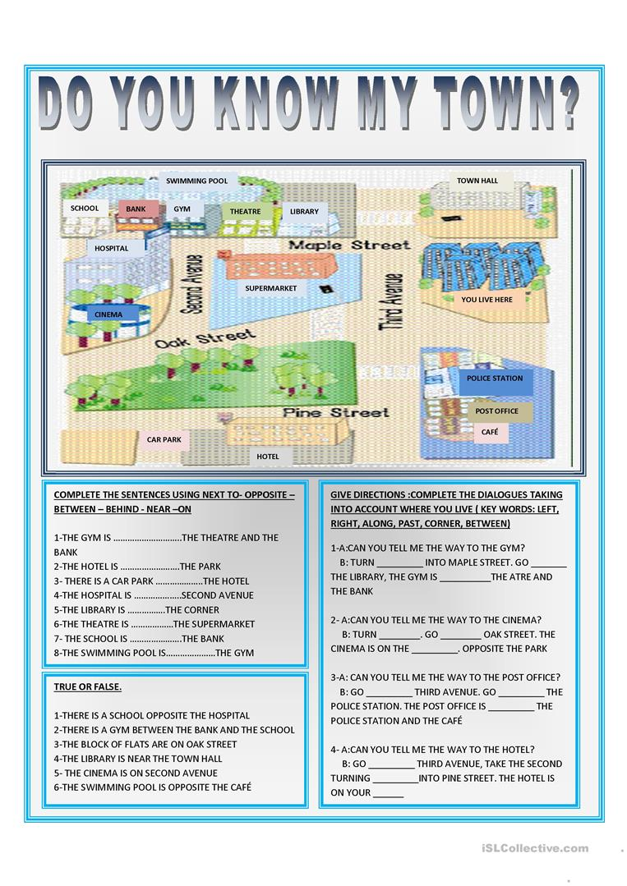

Slide 6

LET`S DO THE FOLLOWING QUIZ!
For each correct answer you get 1 point
0-21 Needs help
3-4-Sufficient
5-7 Good
8-9 very well
10 Excellent

Slide 7
Food Drinks
Clothes
Where can I buy..?
Medicine Furniture
Stamps

Slide 8

Where can I get some money?

Slide 9
Where can I buy a stamp?

Slide 10
Where can I buy some medicine?

Slide 11
Where can I swim ?

Slide 12
Where can I see some old things?

Slide 13
Where can I watch a film?

Slide 14
Where can I get some food?

Slide 15
Where can I meet a doctor ?

Slide 16
Where can I get a train?

Slide 17
Where can I see a policeman?

Slide 18

Check your answers :
1.bank 2.post office 3.pharmacy
4.swimming pool 5 museum
6.cinema 7.supermarket
8.hospital 9 ,train staion
10. police station
Thanks for using my lesson
Teacher : Snezhana Naumova
March, 2020
You may watch the video now: https://youtu.be/V5M2bME1fOg ,
https://www.youtube.com/watch?v=9xBTXX7DgBc
https://www.youtube.com/watch?v=2JFqKRUB2vc

